Slide 1

Finding what you want from a web page
This is a dark art
Web pages are not designed to be read like this
If a webapplication wants you to be able to extract data they use JSON (they used to use XML in RSS feeds).
Case Study: Get the price and address from myhome.ie
We will need the URL
Don’t use inspect because a lot of webpages use javascript to modify themselves, we need to use viewsource or curl
This is a dark art (yep I am saying it again)
ID and class are what you are looking for, possibly tag

Slide 2
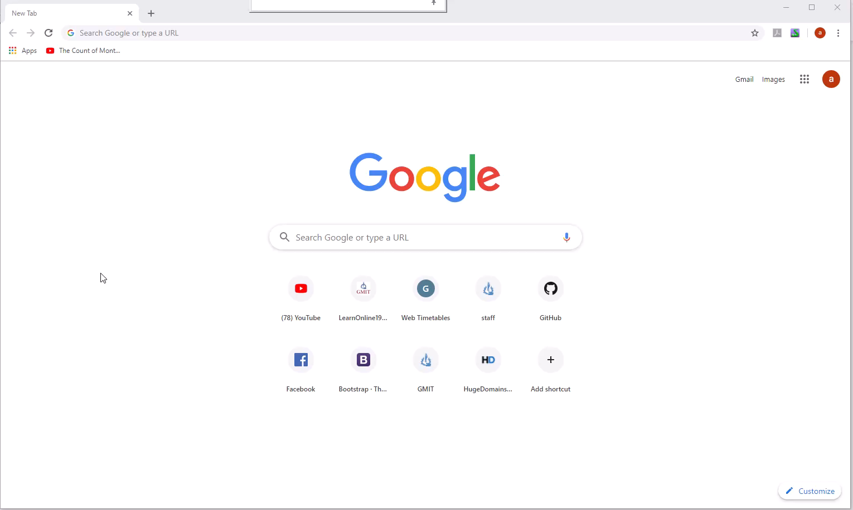

Slide 3
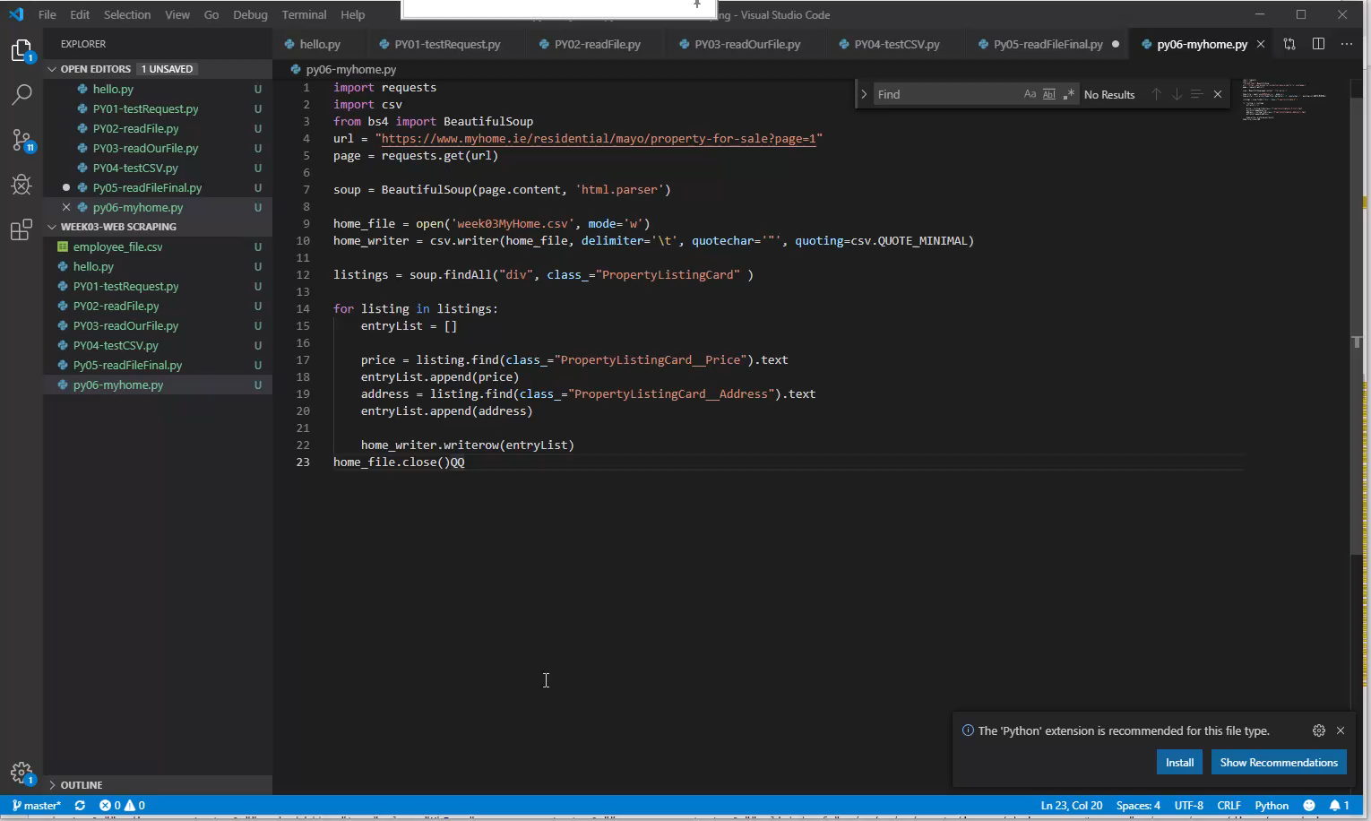

Slide 4
References
A very good tutorial, takes it from html and builds to making a python program to read it. Be warned he is using python2 and we are using python3, the main difference is with the print statements.
https://www.dataquest.io/blog/web-scraping-tutorial-python/
Documentation on BeautifulSoup4
https://buildmedia.readthedocs.org/media/pdf/beautiful-soup-4/latest/beautiful-soup-4.pdf

